Slide 1
Sacred, but Imperfect: A Postmodernist Paradox?
Student: Keaton Cizek
Professor: Catherine Barrett
Class: ARCH 3543 Myth and Measure

Slide 3
St. Nicholas Eastern Orthodox Church, Springdale, Arkansas, Marlon Blackwell, 2009.

Slide 4
Vitruvius’ ordered temples, 1673 French edition illustration

Slide 5
St. Nicholas Eastern Orthodox Church. Exterior of existing metal shop building.

Slide 6
St. Nicholas Eastern Orthodox Church. Tower interior. Photo by Dr. Catherine Barrett.

Slide 7
St. Nicholas Eastern Orthodox Church. Chapel interior. Dome with Pantocrator. Iconostasis. White natural light at east altar.

Slide 8
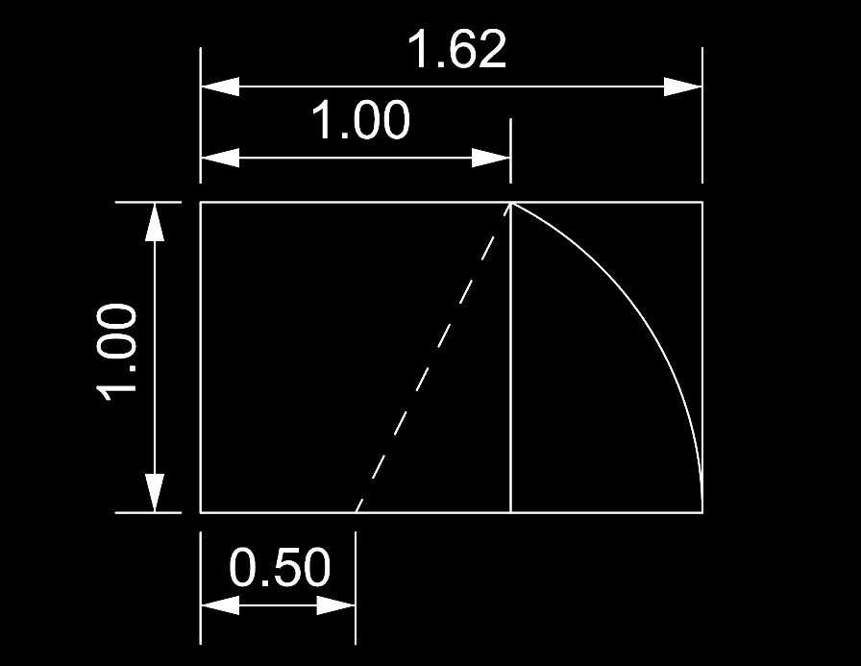
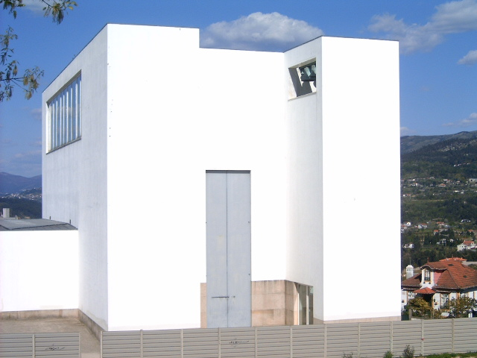
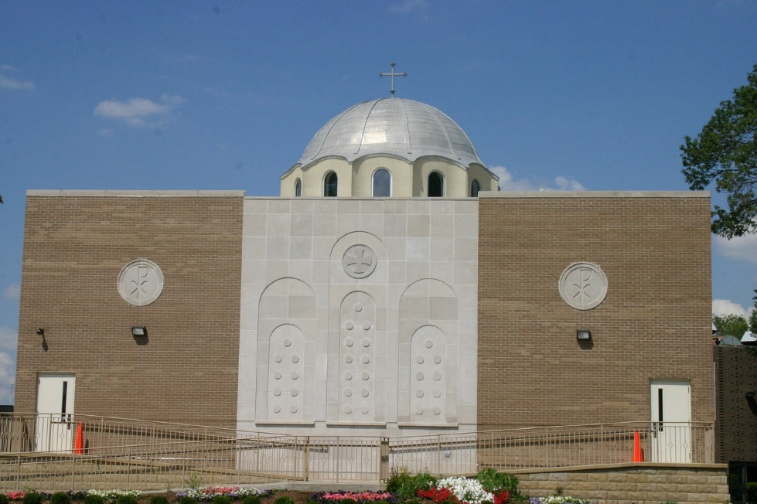
Precedents
St. John the Baptist Greek Orthodox Church, Chicago, IL
The Golden Section (proportion approx. 1:1.62)
Santa Maria Church de Canaveses, Portugal. Architect: Alvaro Siza

Slide 12
