Slide 1
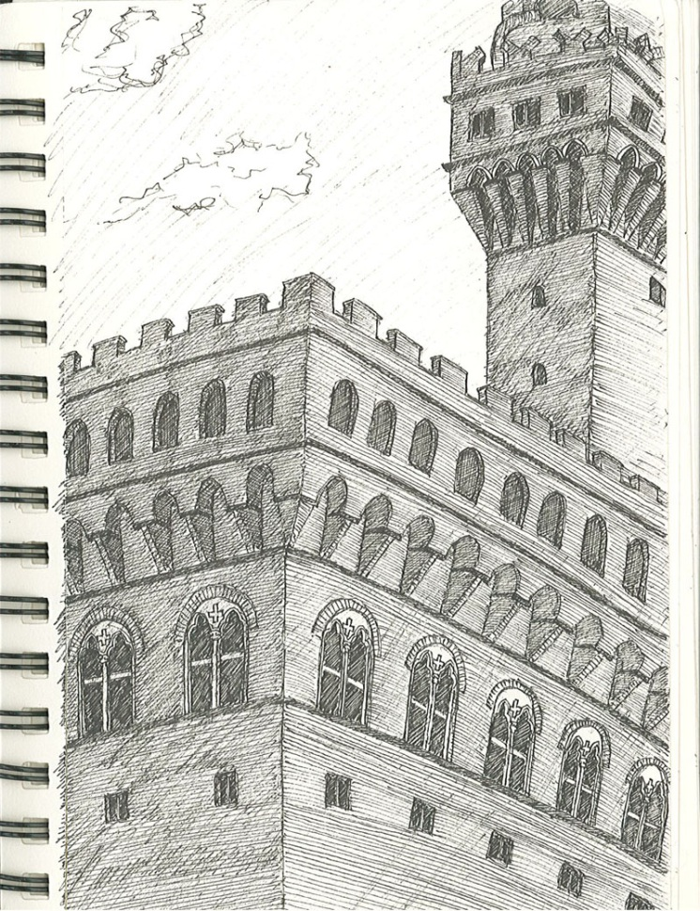
FIELD TRIP TO FLORENCE THURSDAY FEBRUARY 7 THROUGH 10, 2013
PART 2 OF 4 PARTS
Palazzo Vecchio by Cal Cornwell
The sketches are organized into four slide shows related to the assignments, and in alphabetical order by last name, with each student represented by three or four sketches.

Slide 2
II. The Development of the Renaissance Palazzo Façade and Courtyard
Working from at least three of the following palazzi:
Illustrate the history of the development of the Renaissance palazzo façade from the medieval period through 1600 using diagrams and sketches of at least three of the palazzi listed below.
Create a series of sketches which illustrate the challenges and opportunities of designing a courtyard for a Renaissance palazzo. Include plan diagrams and sketches of corner details for at least three of the palazzi listed below.
Palazzo Vecchio
Palazzo Davanzati
Palazzo Medici
Palazzo Ruccellai
Palazzo Strozzi
Palazzo Pitti

Slide 3
Palazzo Vecchio by Amber Conwell

Slide 4
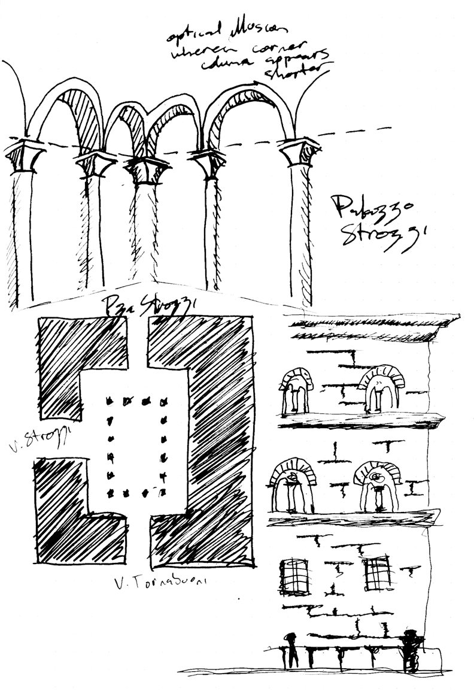
Palazzo Strozzi by Michael Dean

Slide 5
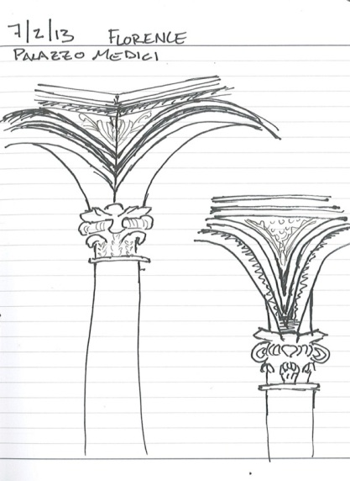
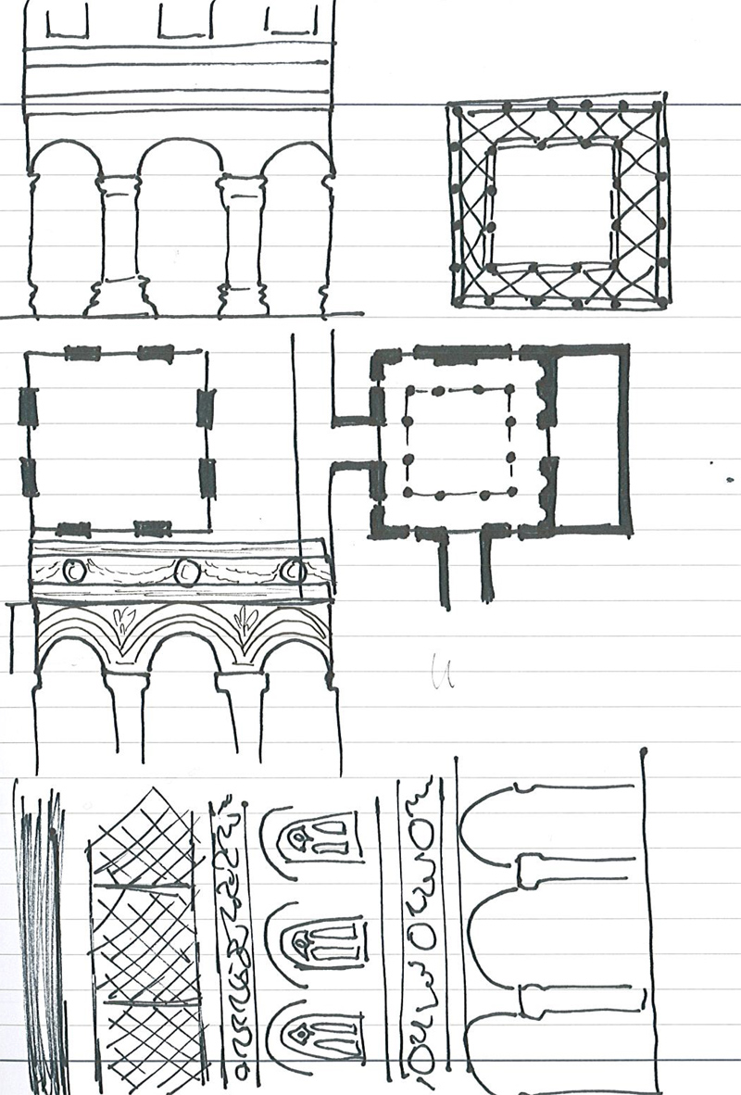
Palazzo Medici by Lena Detter

Slide 6
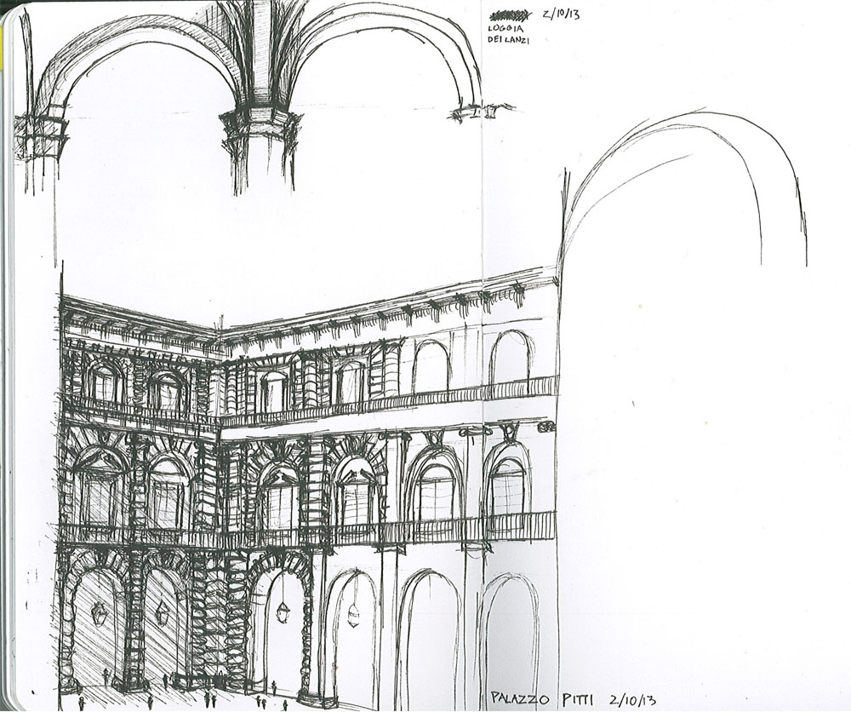
Palazzo Pitti by Nathan Harwell
Notes:
Nathan Harwell

Slide 7
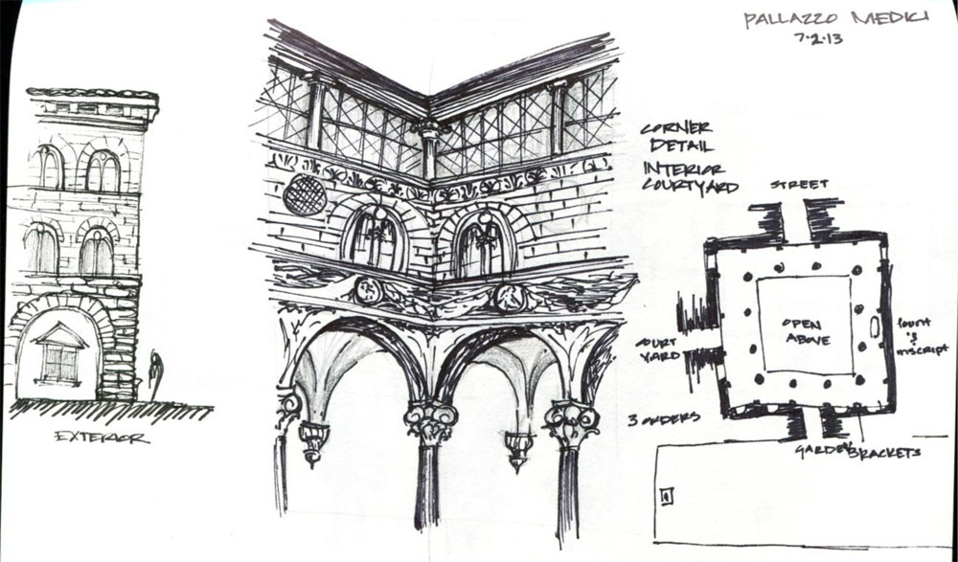
Palazzo Medici by Kymber Kincanon

Slide 8
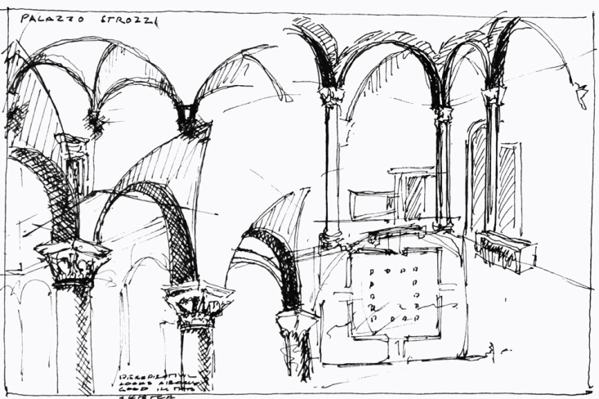
Palazzo Strozzi by Klaas Reimann-Philipp

Slide 9
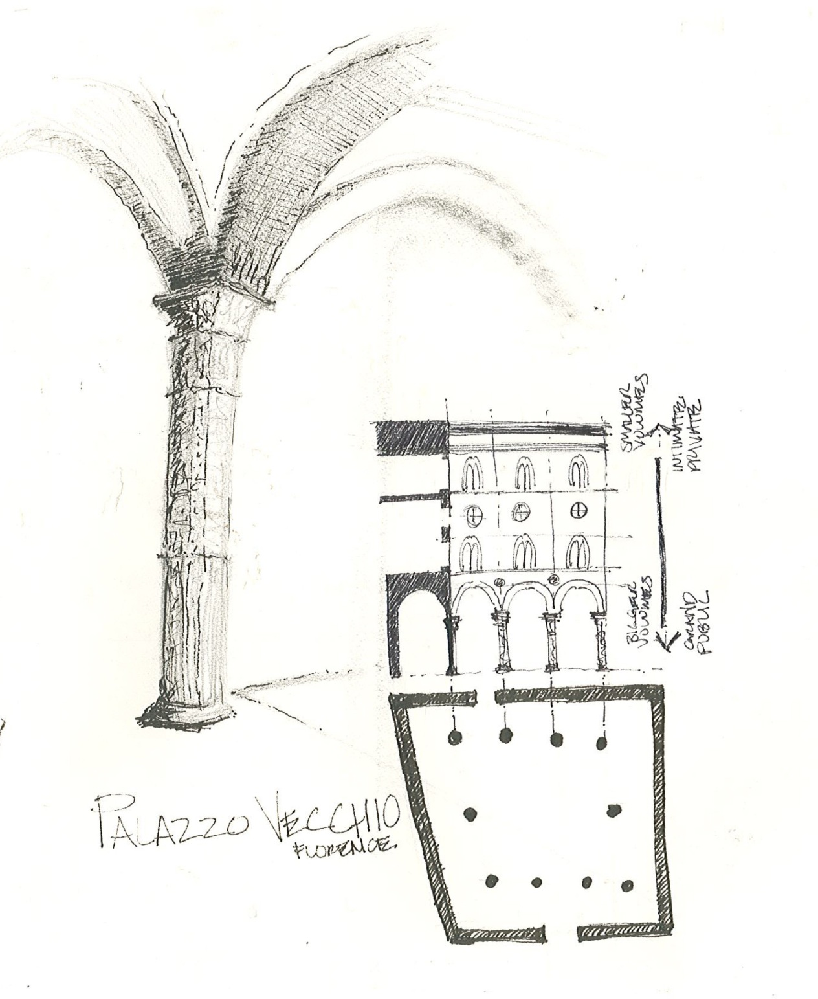
Palazzo Vecchio by Amy Shell

Slide 10
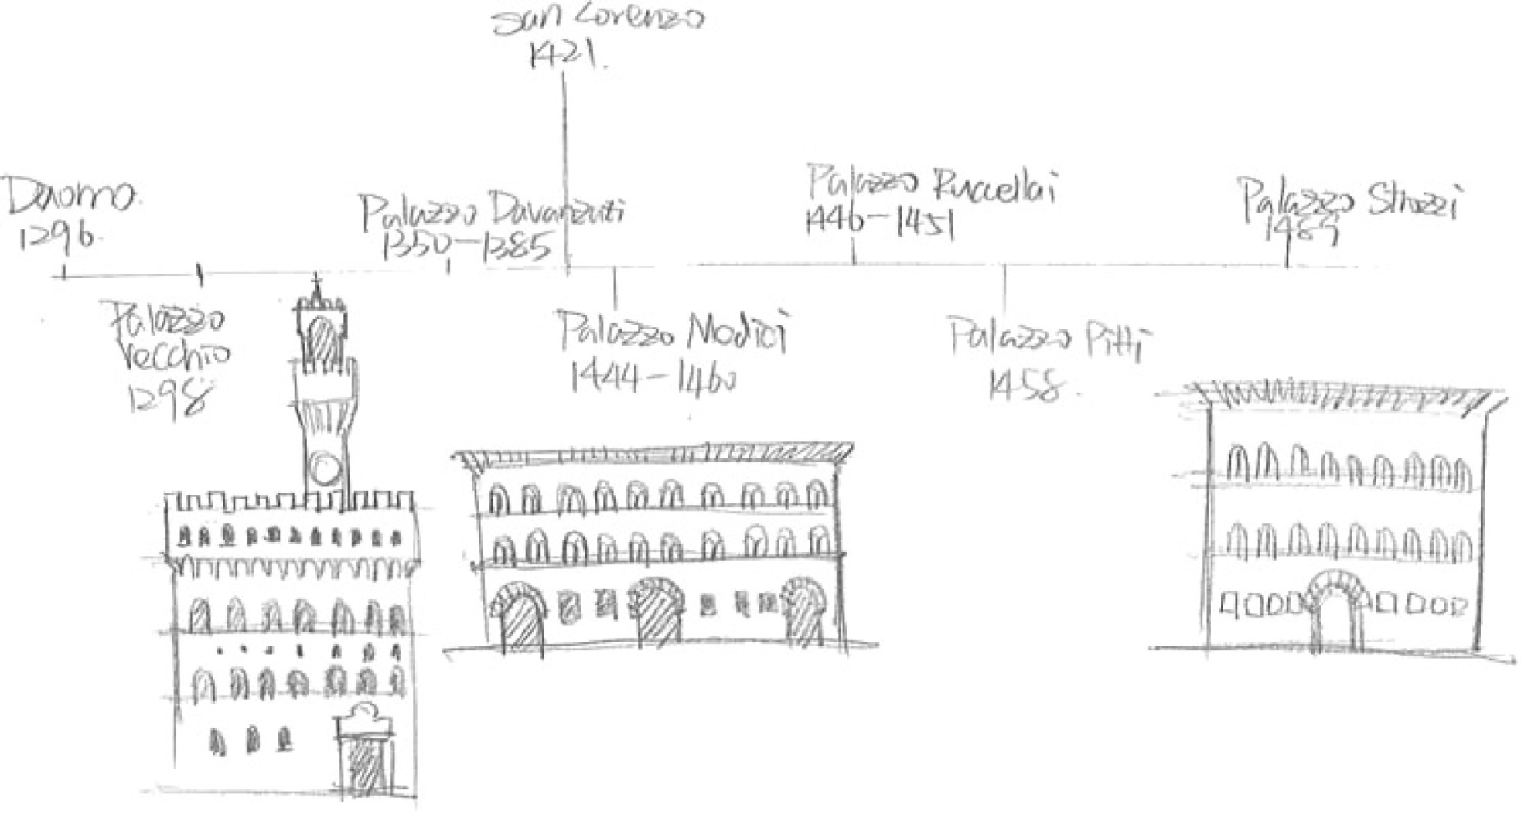
Palazzo Timeline by Yichen Wang

Slide 11
Palazzos Pitti and Medici by Tyler Yamamoto

