Slide 1
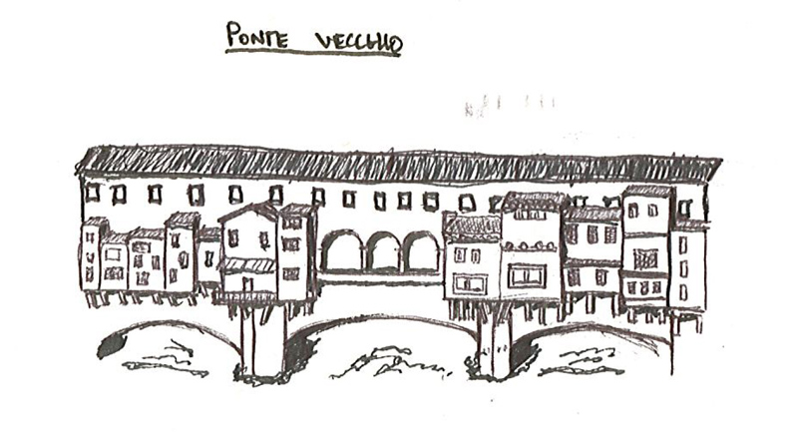
FIELD TRIP TO FLORENCE THURSDAY FEBRUARY 7 THROUGH 10, 2013
PART 4 OF 4 PARTS
Ponte Vecchio by Connor Reid
The sketches are organized into four slide shows related to the assignments, and in alphabetical order by last name, with each student represented by three or four sketches.

Slide 2
IV. River Comparison Diagram
In at least two pairs of diagrams compare the relationship of the river to the city in Florence and Rome. Draw on your memories of the river and city in Rome. Illustrate the differences in characteristics such as the width of the rivers, water level relative to the city, embankments, and scale of the surrounding streets, bridges, and buildings. At least one pair of comparative diagrams should be a section and include the Ponte Vecchio. Be sure to include human figures for scale.

Slide 3
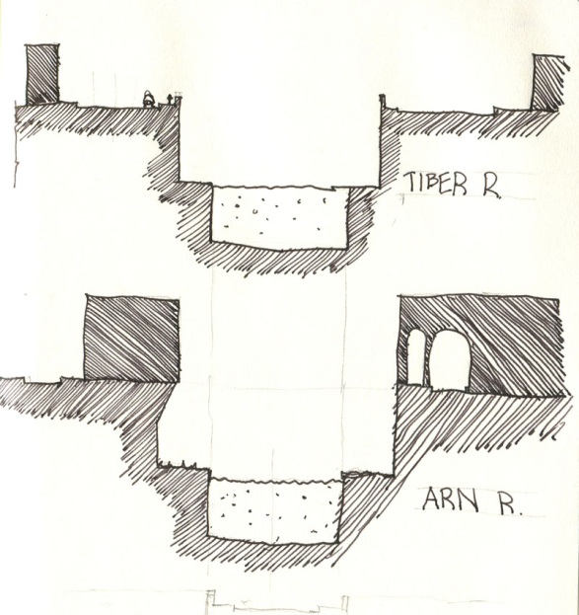
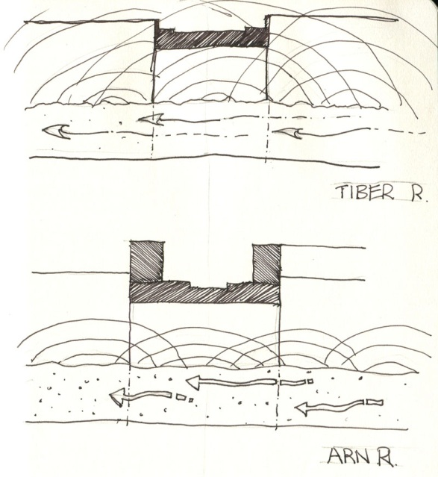
River Study including acoustic analysis by Dustin Blalock

Slide 4
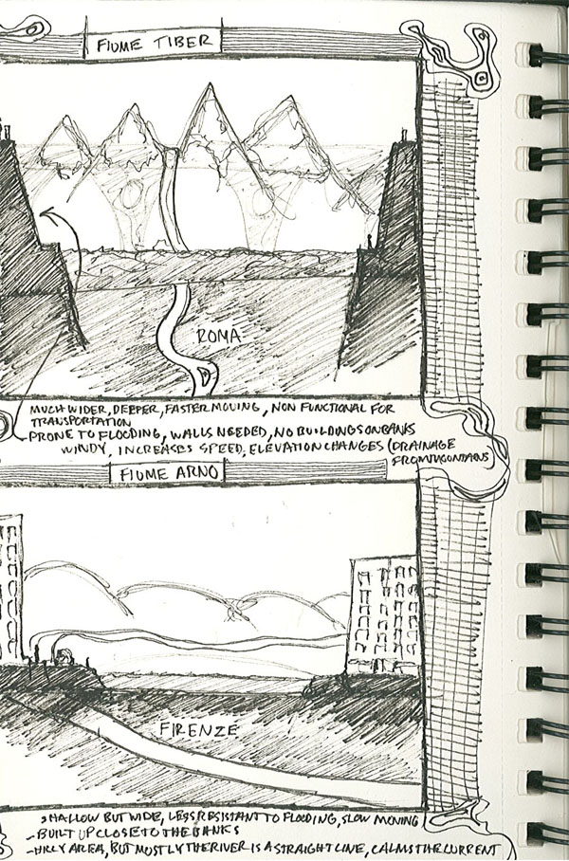
River Study by Cal Cornwell

Slide 5
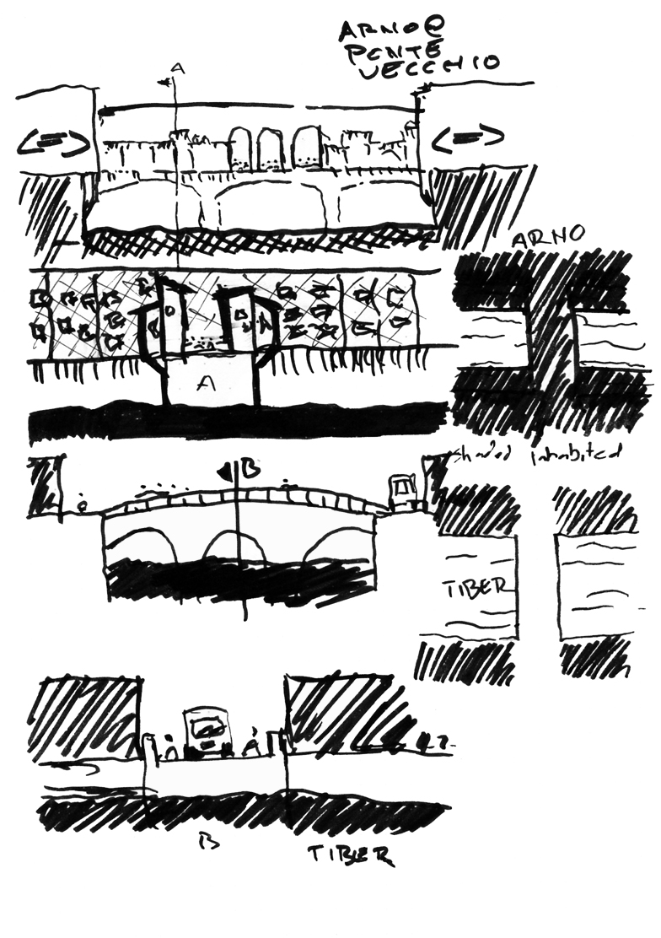
River Study by Michael Dean
Notes:
Michael Dean

Slide 6
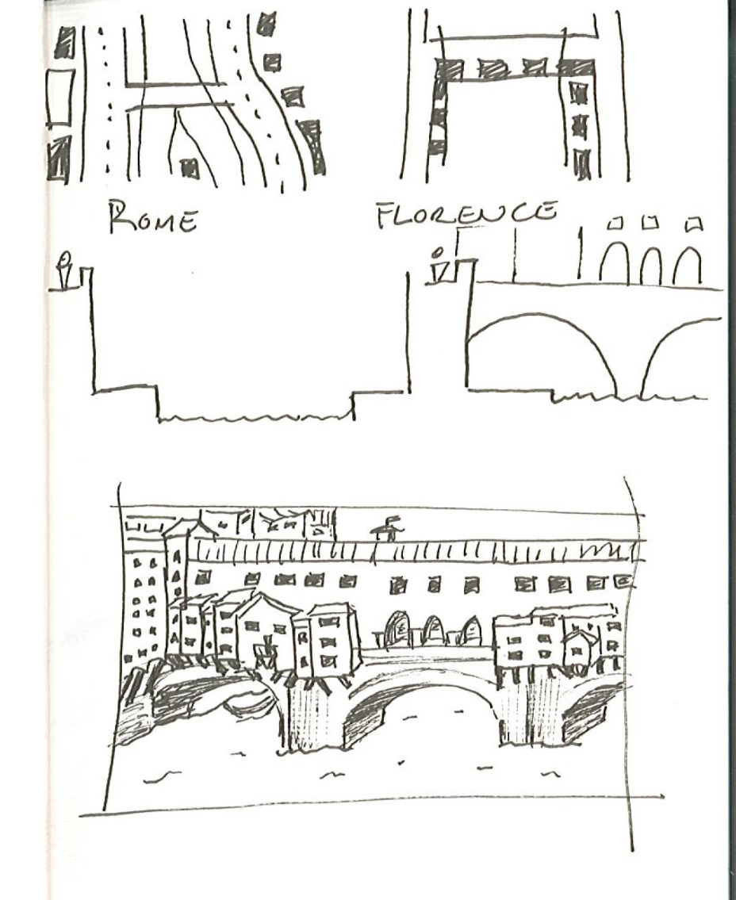
River Studies by Lena Detter

Slide 7
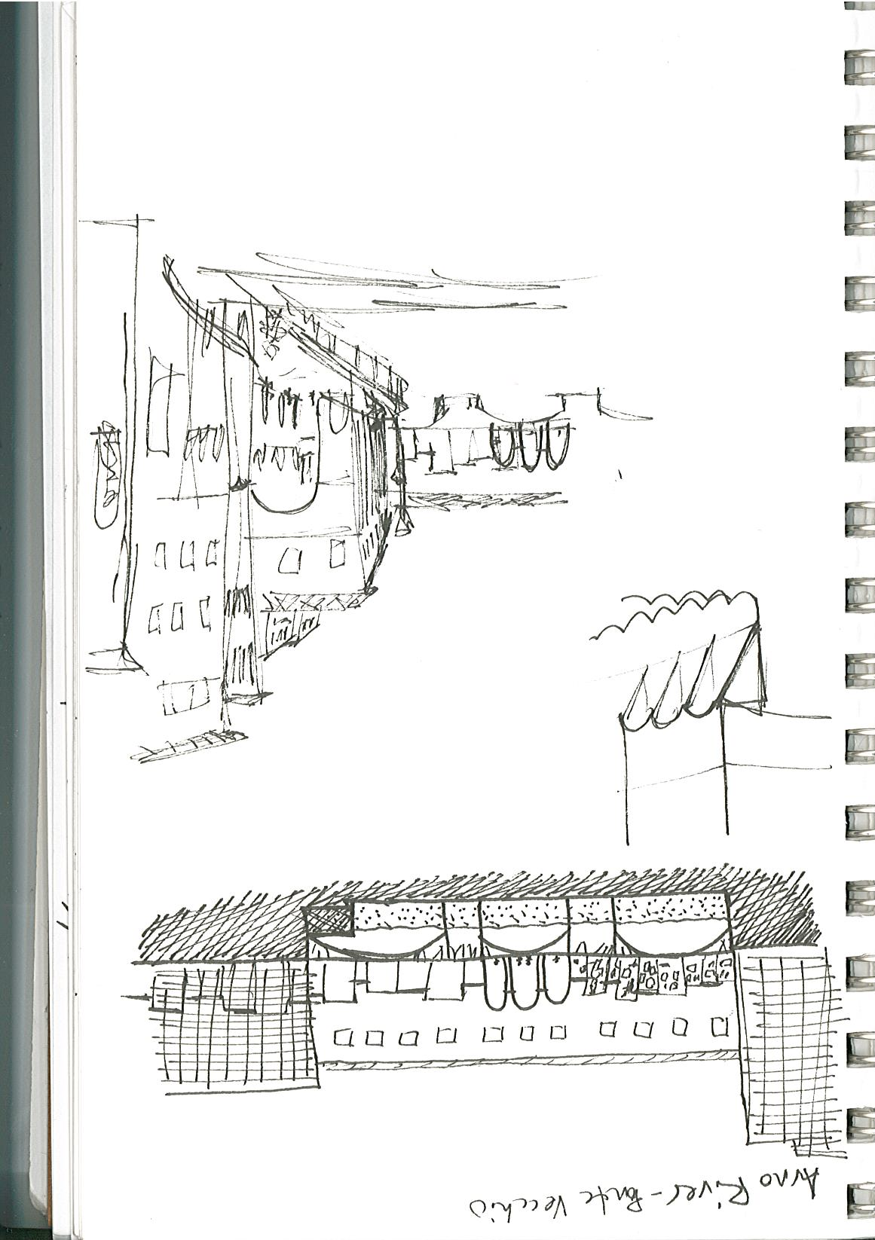
River Study by Annie Kientz

Slide 8
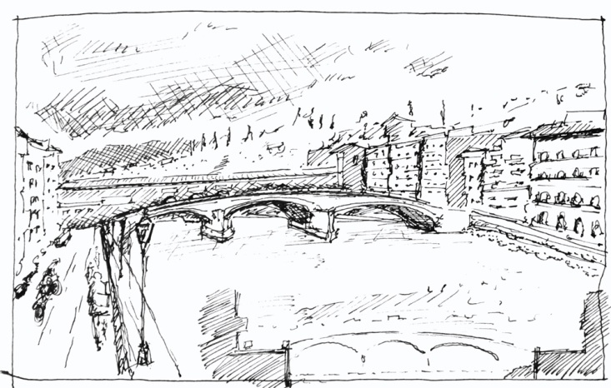
View and Section of the River Arno by Klaas Reimann-Philipp

Slide 9
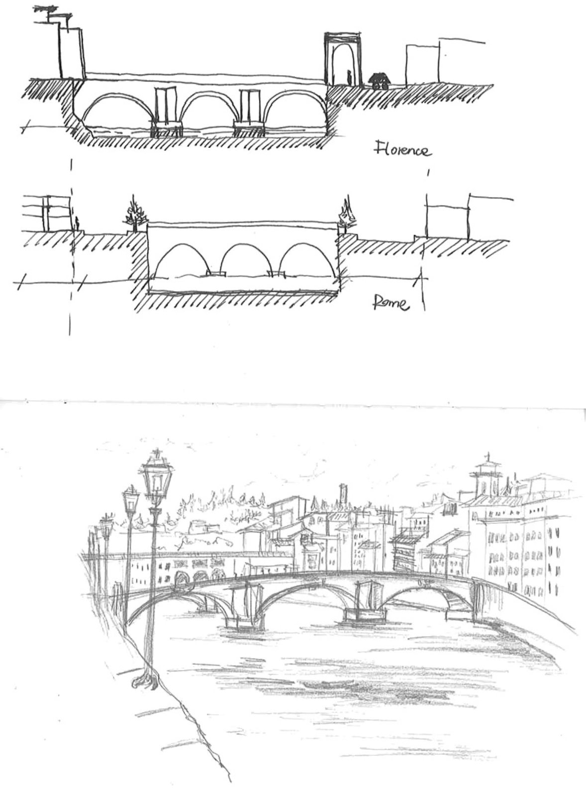
River Studies by Yichen Wang

Slide 10
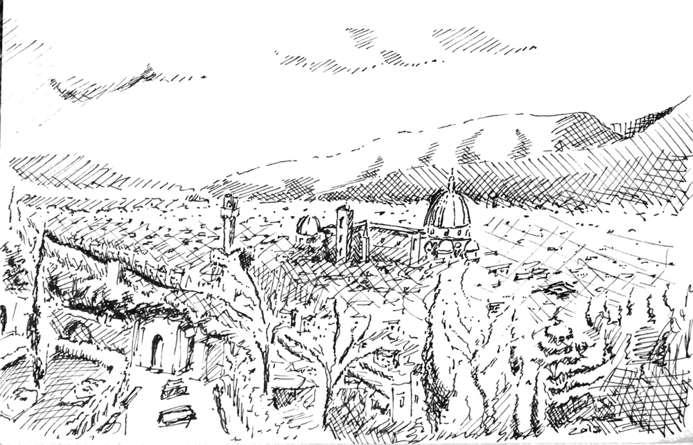
View of Florence from San Miniato, Klaas Reimann-Philipp

